Slide 1
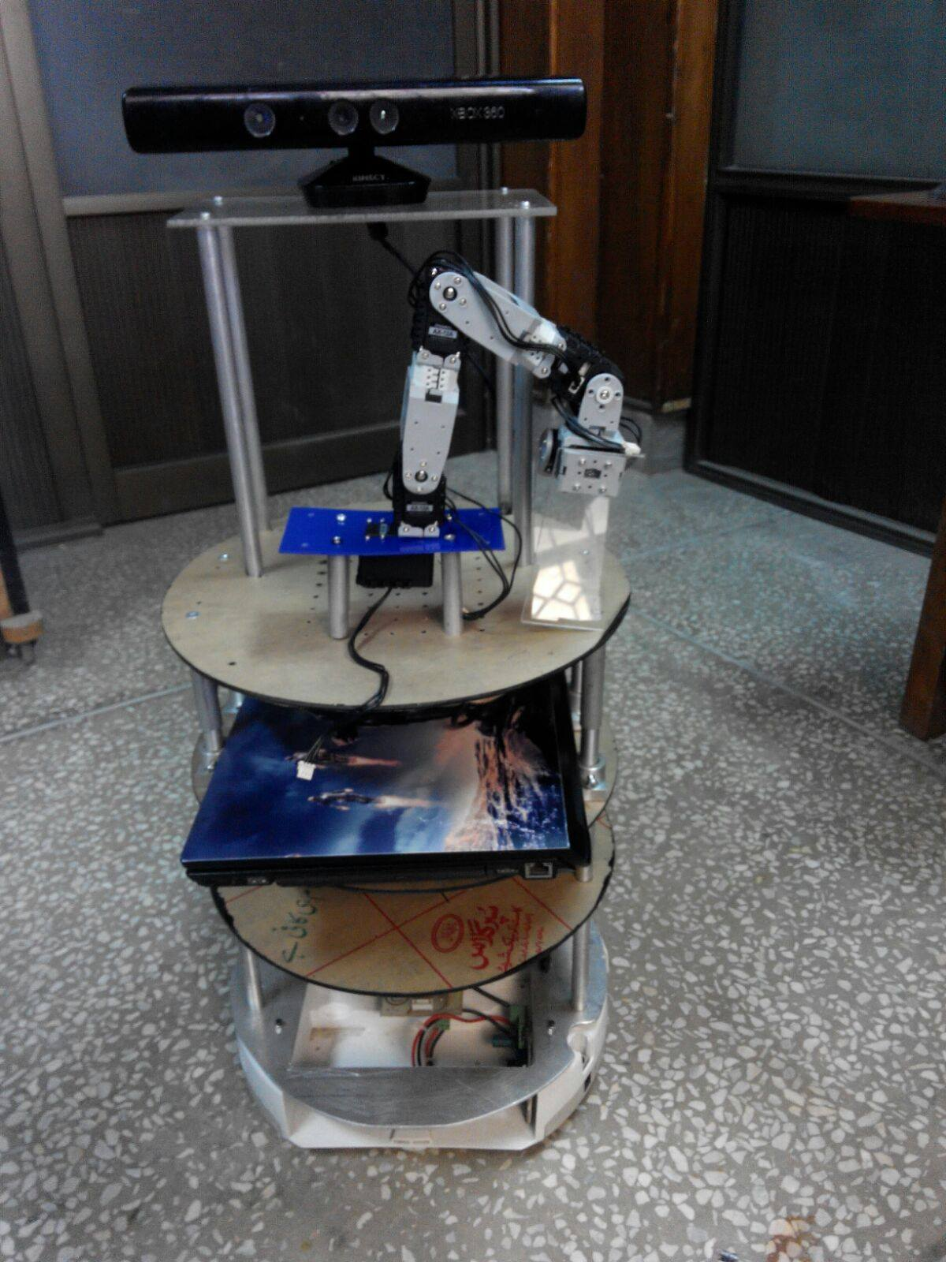
Intelligent Driving System
Supervisors:
Asst Prof Dr Waqar S Qureshi
Lecturer Fatma Faruq
Lecturer Aneeq uz Zaman
Amal, Minha, Anila, Maria & Rabeel

Slide 2




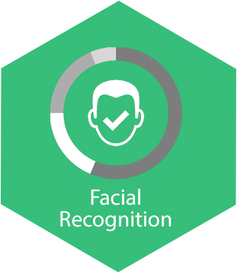

Introduction & Pictorial View
Notes:
<number>

Slide 3
Deliverables
Localization and Mapping in dynamic environments
Navigation in dynamic environments
Voice Recognition & Synthesis
Sound Source Localization
Face Recognition
Person tracking
Object Recognition
Object Manipulation

Slide 4
Work Distribution

Slide 5
OUR PROGRESS

Slide 6
SLAM (Simultaneous Localization & Mapping)
Implementation of ORB SLAM
Point cloud mapping
Localization
Installations

Slide 7
OBJECT RECOGNITION
Technique Implemented: Object Recognition Kitchen (ORK)
Method: Table Top
Building Data base
Training of objects
Recognition of coke cane

Slide 8
FOLLOWER
Using Kinect
Openni

Slide 9
Voice Synthesis + Circuitry
Hark Installation
Pocketsphnix
Developing database
Designing and Building power board & Cargobay board

Slide 10
Face Recognition

